Slide 1
Invasive
Friday, January 02, 2015

Slide 2
68
Total Responses
Date Created: Saturday, September 13, 2014
Complete Responses: 66

Slide 3
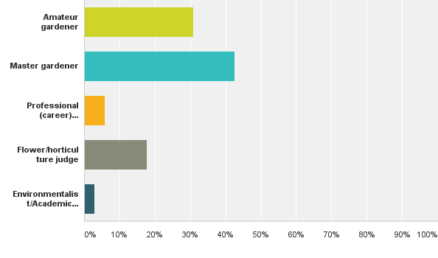
Q1: Please tell us about your background!What option best describes you?
Answered: 68 Skipped: 0

Slide 4
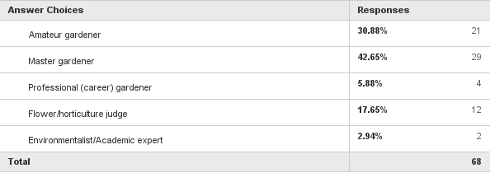
Q1: Please tell us about your background!What option best describes you?
Answered: 68 Skipped: 0

Slide 5
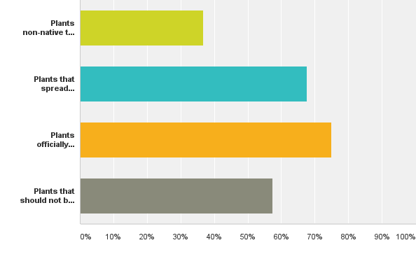
Q2: What does "invasive plant" mean to you?
Answered: 68 Skipped: 0

Slide 6
Q2: What does "invasive plant" mean to you?
Answered: 68 Skipped: 0

Slide 7
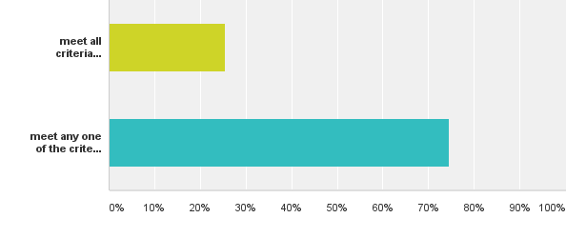
Q3: Referring to the previous question, for a plant to be considered invasive it must...
Answered: 67 Skipped: 1

Slide 8
Q3: Referring to the previous question, for a plant to be considered invasive it must...
Answered: 67 Skipped: 1

Slide 9
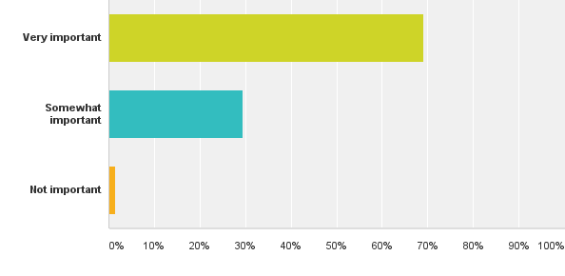
Q4: For you, identifying invasive plants is
Answered: 68 Skipped: 0

Slide 10
Q4: For you, identifying invasive plants is
Answered: 68 Skipped: 0

Slide 11
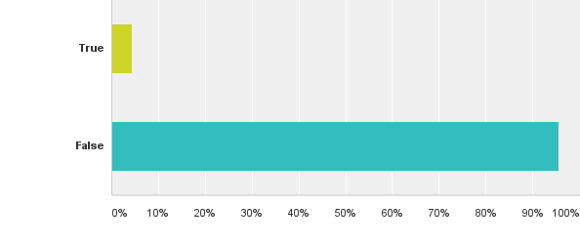
Q5: If I know a plant is invasive, I would still consider growing or selling it
Answered: 68 Skipped: 0

Slide 12
Q5: If I know a plant is invasive, I would still consider growing or selling it
Answered: 68 Skipped: 0

Slide 13
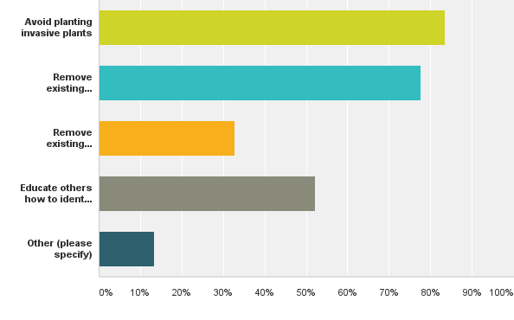
Q6: I have done the following to help eradicate invasive plants
Answered: 67 Skipped: 1

Slide 14
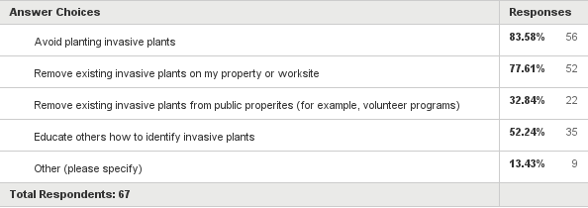
Q6: I have done the following to help eradicate invasive plants
Answered: 67 Skipped: 1

Slide 15
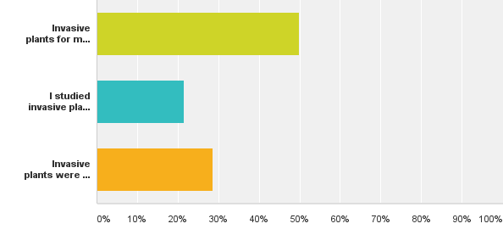
Q7: Regarding my master gardener training,
Answered: 28 Skipped: 40

Slide 16
Q7: Regarding my master gardener training,
Answered: 28 Skipped: 40

Slide 17
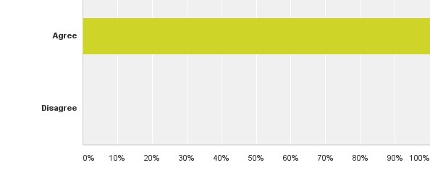
Q8: Invasive plant identification should be part of master gardener training
Answered: 28 Skipped: 40

Slide 18
Q8: Invasive plant identification should be part of master gardener training
Answered: 28 Skipped: 40

Slide 19
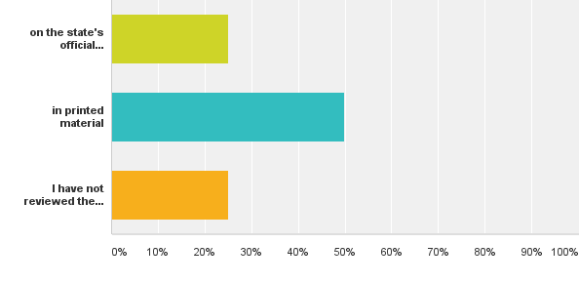
Q9: I have reviewed the list of invasive plants for my state
Answered: 28 Skipped: 40

Slide 20
Q9: I have reviewed the list of invasive plants for my state
Answered: 28 Skipped: 40

Slide 21
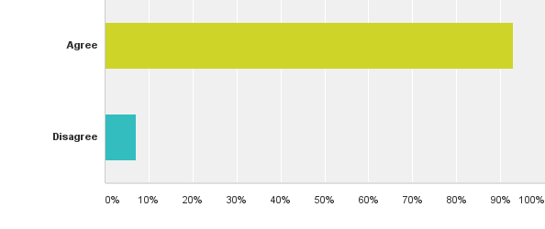
Q10: A master gardener should inform other gardeners and the public about the need to eradicate invasive plants
Answered: 28 Skipped: 40

Slide 22
Q10: A master gardener should inform other gardeners and the public about the need to eradicate invasive plants
Answered: 28 Skipped: 40

Slide 23
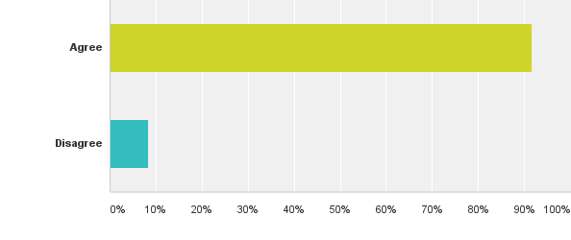
Q13: When judging, invasive plants should be prohibited on the schedule of allowed plants
Answered: 12 Skipped: 56

Slide 24
Q13: When judging, invasive plants should be prohibited on the schedule of allowed plants
Answered: 12 Skipped: 56

Slide 25
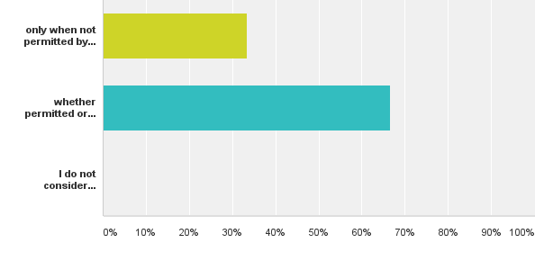
Q14: I inform participants when they have used an invasive plant
Answered: 12 Skipped: 56

Slide 26
Q14: I inform participants when they have used an invasive plant
Answered: 12 Skipped: 56

Slide 27
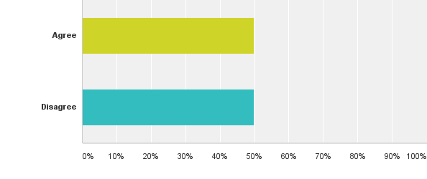
Q16: I teach about invasive plants and their identification
Answered: 2 Skipped: 66

Slide 28
Q16: I teach about invasive plants and their identification
Answered: 2 Skipped: 66

Slide 29
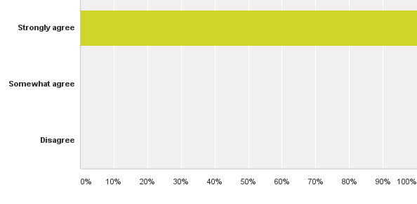
Q17: Invasive plants are an important issue in our environment
Answered: 2 Skipped: 66

Slide 30
Q17: Invasive plants are an important issue in our environment
Answered: 2 Skipped: 66

